Slide 1
Access Control
Presented by: Yawar Abbas

Slide 2
Access Controls
Access controls are security features that control how people can interact with systems, and resources.

Slide 3
Access*
Access is the data flow between an subject and an object.
Subject is a person, process or program
Object is a resource (file, printer etc)
Access controls should support the CIA triad!

Slide 4
Access*
What is the CIA triad?

Slide 5
Components of Access Control (156)
The component of Access Control that we are about to discuss are:
Identification:
Who are you? (user id etc)
Authentication:
Prove you really are who you say you are
Authorization:
What are you allowed to access.
Auditing:
Your access is logged and reviewed.

Slide 6
Identification
Identifies a user uniquely
Identification must be unique for accountability
Standard naming schemes should be used
Identifier should not indicate extra information about user (like job position)

Slide 7
Authentication (160)
Proving who you say you are, usually one of these 3
Something you know
Something you have
Something you are

Slide 8
Authentication (160)
What is wrong with just using one of these methods?
Any single method is weak by itself.

Slide 9
Strong Authentication (159)
Strong Authentication is the combination of 2 or more of these and is encouraged!
Strong Authentication provides a higher level of assurance*
Strong Authentication is also called multi-factor authentication*

Slide 10
Authorization
The concept of ensuring that someone who is authenticated is allowed access to a resource.
Authorization is a preventative control*

Slide 11
Auditing
Logging and reviewing accesses to objects.
What is the purpose of auditing?
Auditing is a detective control*

Slide 12
Identity Management

Slide 13
Identity Management (160)
Identity management products are used to identify, authenticate and authorize users in an automated means.

Slide 14
Identity Management (160)
It’s a broad term.

Slide 15
Identity Management (160)
These products may include
Directories
User account management
Profiles
Access controls
Password management
Single Sign on
Permissions

Slide 16
Password Management In ID systems
Allows for users to change their passwords,
May allow users to retrieve/reset password automatically using special information (challenge questions) or processes
Helpdesk assisted resets/retrievals
May handle password synchronization

Slide 17
Authentication

Slide 18
Biometrics (179)
Bio -life
Metrics - measure
Biometrics verifies (authenticates) an individuals identity by analyzing unique personal attribute
Require enrollment before being used*
EXPENSIVE
COMPLEX

Slide 19
Biometrics
Can be based on
behavior (signature dynamics) – might change over time
Physical attribute (fingerprints, iris, retina scans)
We will talk about the different types of biometrics later

Slide 20
Biometrics
Can give incorrect results*
False negative – Type 1 error* (annoying)
False positive – Type 2 error* (very bad)
A “false positive” occurs when the system incorrectly matches an input to a non-matching template, while in a “false negative”, the system fails to detect a match between an input and a matching template.

Slide 21
Biometric problems?
Expensive
Unwieldy
Intrusive
Can be slow (should not take more than 5-10 seconds)*
Complex (enrollment)
Privacy Issues

Slide 22
Biometric Types Overview
We will talk in more depth of each in the next couple slides
Fingerprint
Hand Geometry
Retina Scan
Iris Scan
Keyboard Dynamics
Keyboard Dynamics
Voice Print
Facial Scan

Slide 23
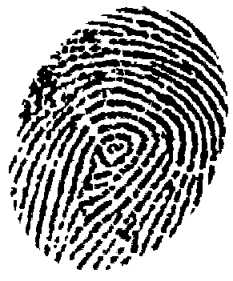
Finger Print

Slide 24
Fingerprint
Measures ridge endings an bifurcations (changes in the qualitative or topological structure) and other details called “minutiae”
Full fingerprint is stored, the scanners just compute specific features and values and sends those for verification against the real fingerprint.

Slide 25
Hand Geometry
Measures:
Overall shape of hand
Length and width of fingers

Slide 26
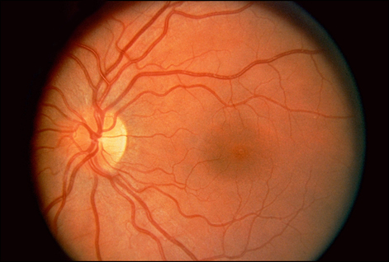
Retina Scan

Slide 27
Retina Scan
Reads blood vessel patterns on the back of the eye.
Patterns are extremely unique
Retina patters can change
Can possibly be a privacy issue
Place scanner so sun does NOT shine through aperture*

Slide 28
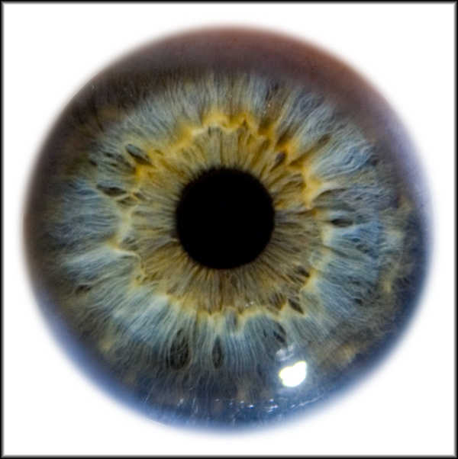
Iris Scan

Slide 29
Iris Scan
Measures
Colors
Rifts
Rings
Furrows (wrinkle, rut or groove)
Has the most assurance of all biometric systems*
IRIS remains constant through adulthood
Place scanner so sun does NOT shine through aperture*

Slide 30
Signature Dynamics
Work on the fact that most people sign in the same manner, and this is hard to reproduce
Monitor the motions and the pressure while moving (as opposed to a static signature)
Type I error rate is high
Type II error rate is low

Slide 31
Keyboard dynamics
Measure the speeds and motions as you type, including timed difference between characters typed. For a given phrase
This is more effective than a password
it is hard to repeats someone's typing style, where as it’s easy to get someone's password.

Slide 32
Voice Print
Measures speech patterns, inflection and intonation (i.e.. pitch and tone)
For enrollment, you say several different phrases.
For authentication words are jumbled.

Slide 33
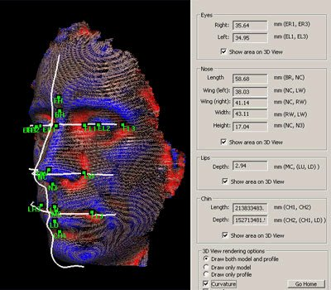
Facial Scan

Slide 34
Facial Scan
Geometric measurements of
Bone structure
Nose ridges
Eye width
Chin shape
Forehead size

Slide 35
Hand Topography
Peaks and valleys of hand along with overall shape and curvature
This is opposed to size and width of the fingers (hand geometry)
Camera on the side at an angle snaps a pictures
Not unique enough to stand on it’s own, but can be used with hand geometry to add assurance

Slide 36
Biometrics wrap up
We covered a bunch of different biometrics
Understand some are behavioral* based
Voice print
Keyboard dynamics
Can change over time
Some are physically based
Fingerprint
Iris scan

Slide 37
Biometrics wrap Up
Fingerprints are probably the most commonly used and cheapest*
Iris scanning provides the most “assurance”*
Some methods are intrusive*
Biometrics do cause privacy issues*

Slide 38
Biometrics Wrap up
Understand Type I and Type II errors
Be able to define CER, is a lower CER value better or worse?

Slide 39
Passwords

Slide 40
Passwords (184)
Password – A protected string of characters that one uses to authenticate themselves.
Password authentication is:
Something you know

Slide 41
Passwords (184)
Password traits
Simplest form of authentication*
Cheapest form of authentication*
Oldest form of authentication
Most commonly used form of authentication*
Weakest form of authentication*

Slide 42
Problems with Passwords
People write down passwords
People use weak passwords
People re-use passwords
If you make passwords to hard to remember then people write them down
If you make them too easy then they are easily cracked

Slide 43
Password Management
Proper Password Management, including password policies can help mitigate some of the problems with passwords.
First choose a strong password!
Minimum password lengths - 8
Case changes, number and special characters
1 or more A-Z
1 or more a-z
1 or more 0-9
1 or more special character
No personal information (usernames, real name, children's names, birthdates)

Slide 44
Password Management
Use a password checker before accepting a new password
The OS should enforce password requirements
Aging –when a password expires
Minimum password age: days to weeks
Maximum password age : 60-90 days
Reuse of old passwords (password history)
Minimum number of characters
Limit login attempts – disable logins after a certain number of failed attempts
(more)

Slide 45
Password Management
System should NOT store passwords in plaintext, hash them instead.
Use passwords salts
random values added to the encryption/hash process to make it harder to brute force (one password may hash/encrypt to multiple different results)
You can encrypt hashes… (Windows SYSKEY)… but…

Slide 46
Passphrases (190)
I like to use a “passphrase” to generate a password
I Like Iced Tea and Cranberry with Lemon
I L I T A C W L
1 L 1 t @ c w l
All people seems to need data processing
Ap$tnDp1

Slide 47
Attacks on Password
Sniffing (Electronic Monitoring)
Dictionary Attack
Brute force attacks
Social Engineering
Rainbow tables

Slide 48
Virtual Password
Simply a phrase, application will probably make a “virtual password” from the passphrase (etc a hash)
Generally more secure than a password
Longer
Yet easier to remember

Slide 49
Cognitive passwords (187)
Facts that only a user should know.
Can be used by helpdesk authenticate a user without revealing the password.
Often used for password reset challenges

Slide 50
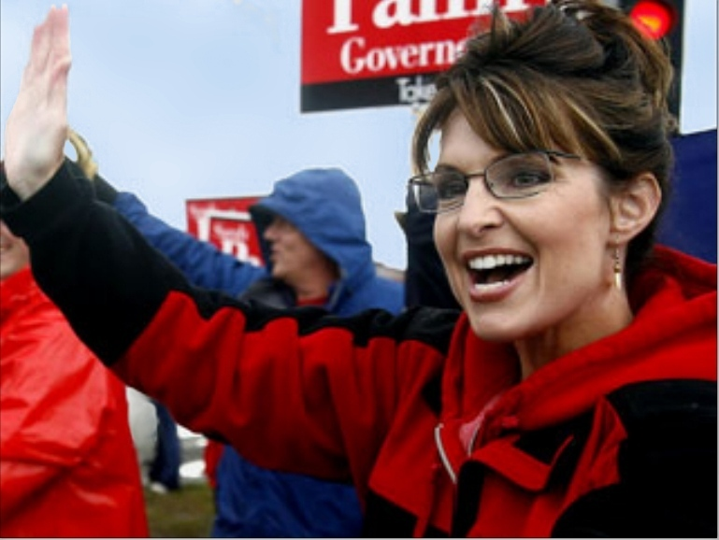
Problems with cognitive passwords
Not really secure. I’m not a big fan.

Slide 51
Cognitive Passwords (187)
“As detailed in the postings, the Palin hack didn’t require any real skill. Instead, the hacker simply reset Palin’s password using her birthdate, ZIP code and information about where she met her spouse — the security question on her Yahoo account, which was answered (Wasilla High) by a simple Google search.”
https://en.wikipedia.org/wiki/Sarah_Palin_email_hack

Slide 52
One Time Password
Password that is used only once then no longer valid
Used in high security environments
VERY secure
Not vulnerable to electronic eavesdropping, but vulnerable to loss of token.
Require a token device to generate passwords. (RSA SecureID key is an example)

Slide 53
One Time Password Token Type
One time passwords are one of two types that we are about to discuss.
Synchronous
Asynchronous

Slide 54
Synchronous One Time Password
Synchronous – uses time to synchronize between token and authentication server
Clocks must be synchronized!
Can also use counter-sync which a button is pushed that increments values on the token and the server

Slide 55
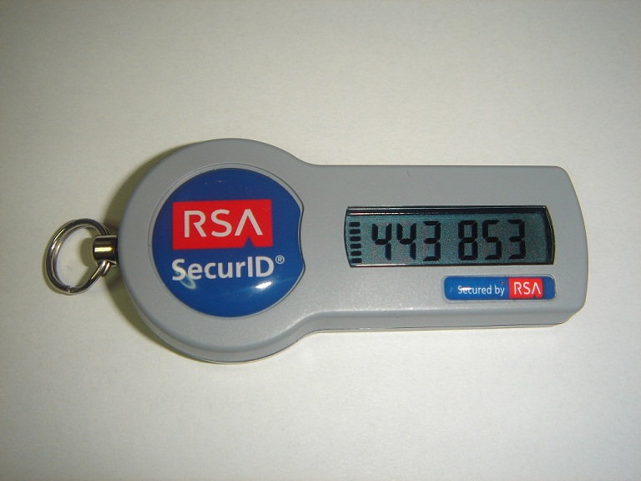
Synchronous One Time Password

Slide 56
OTP Token Types (187)
Asynchronous
Challenge response
Auth sends a challenge (a random value called a nonce)*
User enters nonce into token, along with PIN
Token encrypts nonce and returns value
Users inputs value into workstation
If server can decrypt then you are good.

Slide 57
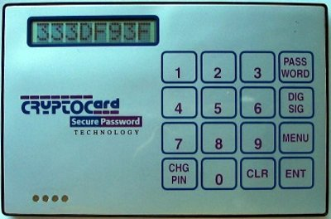
Challenge OTP

Slide 58
Other Types of Authentication ()
Other types of Authentication that we are about to discuss are
Digital Signatures
Memory Cards
Smart Cards

Slide 59
Digital Signatures
Digital Signature (talk about in more depth in chapter 8).
Take a hash value of a message, encrypt hash with your private key
Anyone with your public key can decrypt and verify message is from you.

Slide 60
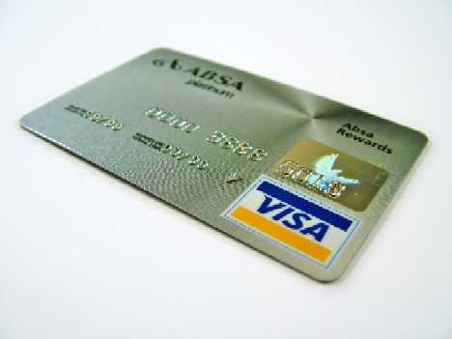
Memory Cards

Slide 61
Memory Cards (190)
NOT a smart card
Holds information, does NOT process
A memory card holds authentication info, usually you’ll want to pair this with a PIN… WHY?
A credit card or ATM card is a type of memory card, so is a key/swipe card
Usually insecure, easily copied.*

